Slide 1
IBM University Engagement Project Submission
AI-Powered Multi-Agent Pathology Assistant using IBM Granite & LangFlow

Slide 2

Project Tile – Smart Study Generator Agent
Domain of Project –AI in Education
Faculty Name | Recent Passport Photo | Email ID | Mobile number [WhatsApp]
Dr. Jitendra H. Darji |  | Jhdarji.mca@gmail.com | 9879203225

Slide 3
Problem Statement -
Students often struggle with information overload due to the abundance of educational resources available across various platforms.
Traditional learning tools provide static assistance and fail to personalize content according to individual learning needs.
The challenge is to develop an Agentic AI-powered Study Companion that autonomously retrieves relevant study materials, summarizes complex topics, generates personalized learning plans, creates quizzes, and provides real-time academic support to improve learning outcomes and exam readiness.
Solution-
An Agentic AI-powered Study Material Generator built using LangFlow, IBM watsonx.ai, and IBM Granite Models.
The system uses a Study Material Agent to generate summaries and learning content, and an Educational Mentor Agent to create quizzes, revision notes, and personalized study plans.
The solution helps students learn effectively, reduce information overload, and improve exam preparation.

Slide 4
Technology Used
Study Material Agent – Retrieves and organizes learning content.
Summarization Agent – Generates concise notes and key concepts.
Quiz Generation Agent – Creates practice questions and flashcards.
Exam Preparation Agent – Provides personalized study plans and revision strategies.
This aligns very well with the IBM evaluation criteria because it highlights:
IBM watsonx.ai ✅
IBM Granite Models ✅
Agentic AI ✅
LangFlow Workflow ✅
Educational Use Case ✅

Slide 5
Proposed Solution -
The proposed solution is an AI-powered Smart Study Companion built using LangFlow, IBM watsonx.ai, and IBM Granite Models.
The system helps students organize study materials, generate summaries, create quizzes, and receive personalized learning recommendations.
Multiple AI agents work together to provide adaptive learning support, improve understanding of concepts, and help students prepare effectively for exams.

Slide 6
Multi-Agent Study Companion Workflow: Chat Input → Study Agent → Learning Agent → Chat Output
Chat Input – Students enter questions, topics, or study materials.
IBM watsonx AI Agent – Processes queries and provides personalized learning support.
IBM Granite-4.0-8B-Instruct – Generates summaries, explanations, quizzes, and study recommendations.
Chat Output – Displays AI-generated answers, notes, quizzes, and study plans.
File Component – Stores and retrieves study notes, PDFs, and learning resources.
Study Planner Agent – Creates personalized study schedules and exam preparation plans.

Slide 7
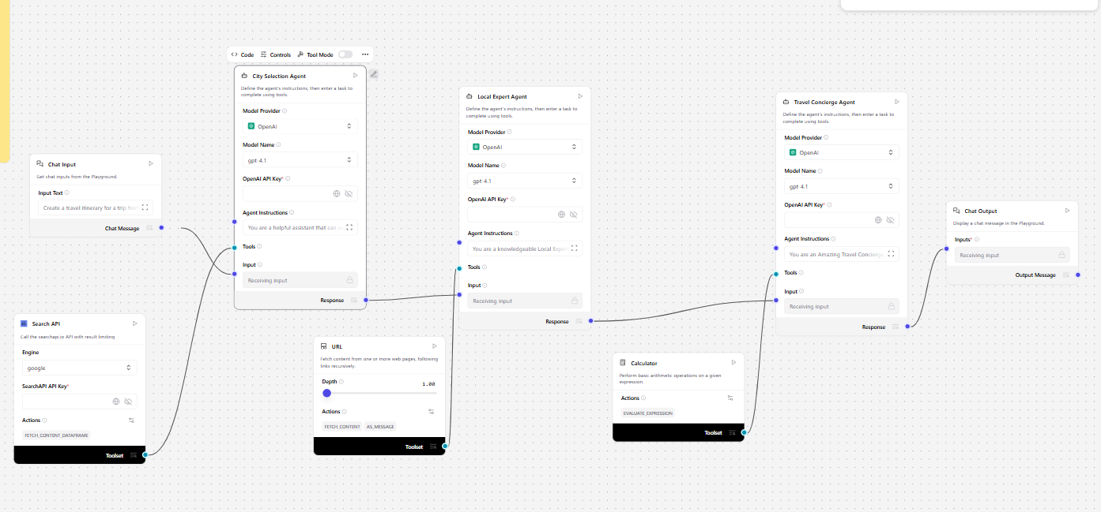
Chat Input, IBM watsonx AI Agent, Granite Model, Chat Output, File Components

Slide 8

User Query → Pathology Analysis Agent → Secondary Expert Agent → Response

Slide 9

Agentic AI architecture with coordinated healthcare reasoning agents
Role of Agentic AI in Nutrition Agent
Agentic AI enables the Nutrition Agent to function as an intelligent, autonomous system rather than a simple chatbot. Using IBM watsonx.ai and IBM Granite models, it coordinates multiple specialized agents to deliver personalized nutrition guidance.
Each agent performs a specific role—such as retrieving nutritional data, generating diet plans, providing health advice, and analyzing food logs—while working collaboratively. This multi-agent approach ensures efficient task execution and accurate results.
Agentic AI also brings context awareness, understanding user details like age, health conditions, and fitness goals to generate tailored recommendations. It supports real-time adaptation, continuously updating suggestions based on user inputs like daily meals.
Additionally, agents communicate with each other, enabling better decision-making and improved outcomes.
Overall, Agentic AI makes the system proactive, personalized, and goal-driven, acting like a smart digital nutritionist that helps users maintain a healthy lifestyle.

Slide 10
Autonomous task delegation, medical context understanding, and collaborative reasoning
Langflow platform -For designing and orchestrating multi-agent workflows visually
IBM Grainte model - for eg – ibm-granite-3-2-8b – For natural language understanding, reasoning, and personalization
IBM Cloud – It provides the infrastructure to build, deploy, and scale the Nutrition Agent efficiently. IBM Cloud enables a reliable, secure, and scalable environment for deploying the Nutrition Agent.
RAG– RAG to fetch real data first, then generate intelligent answers, making the Nutrition Agent more trustworthy and effective.
IBM Watsonx.ai - For model deployment, embeddings, and AI governance
Vector Database (FAISS/Chroma) – For RAG-based nutritional data retrieval

Slide 11
Multi-agent pathology reasoning using IBM Granite models and LangFlow orchestration
The proposed Nutrition Agent stands out by combining Agentic AI, RAG, and personalization into a single intelligent system.
Multi-Agent Intelligence – Instead of a single chatbot, multiple specialized agents collaborate to deliver accurate and context-aware nutrition guidance.
RAG-Based Accuracy – Integrates real-time data retrieval with AI generation, reducing misinformation and ensuring trustworthy recommendations.
Hyper-Personalization – Tailors diet plans based on health conditions, cultural preferences, and fitness goals.
Real-Time Feedback Loop – Continuously adapts recommendations based on daily food logs and user behavior.
Multi-Modal Input – Supports text, voice, and image-based meal tracking for better usability.
Preventive Healthcare Focus – Goes beyond diet planning to provide disease-specific nutrition advice.
Scalable & Enterprise-Ready – Built on IBM watsonx.ai with IBM Granite models, ensuring reliability and governance.
This makes the solution a smart, adaptive, and proactive digital nutritionist, not just a static diet recommendation tool.

Slide 12
Github Link
https://github.com/jhdarjimca-boop/STudy-Material-Generator
·
·
·

Slide 13
Future Scope
1.Integration with Wearables & Health Devices –
The system can be integrated with smartwatches and fitness trackers to collect real-time data such as steps, calories burned, heart rate, and sleep patterns. This will enable the Nutrition Agent to provide more accurate and dynamic diet recommendations based on actual user activity and health metrics.
2.AI-Powered Voice Assistant & Multilingual Support –
Enhancing the system with a voice-enabled assistant and support for multiple languages will improve accessibility. Users can interact naturally in their preferred language, making the solution more inclusive and suitable for diverse populations, especially in regions with varied linguistic backgrounds.
·
·
·

Slide 14


